Slide 1
Chapter
11
Enterprise Applications and Business Process Integration

Slide 2
Management Information Systems
Chapter 11 Enterprise Applications and Business Process
Integration
OBJECTIVES
Assess how enterprise systems provide value for businesses and describe how they work
Assess how supply chain management systems provide value for businesses and describe how they work
Assess how customer relationship management systems provide value for businesses and describe how they work

Slide 3
Management Information Systems
Chapter 11 Enterprise Applications and Business Process
Integration
OBJECTIVES (Continued)
Explain how enterprise applications can be used in platforms for new cross-functional services
Identify the challenges posed by enterprise applications and management solutions

Slide 4
Management Information Systems
Chapter 11 Enterprise Applications and Business Process
Integration
PNC Bank Case
Challenge: develop a single view of corporate and private banking customers; overcome historic segmentation of customers by product and location
Solutions: develop a customer relationship management system (CRM) and data warehouse to integrate customer data from diverse legacy systems
Enable a single view of corporate customers
Illustrates the role of enterprise systems in developing a holistic view of customers and achieving higher customer loyalty and profitability

Slide 5
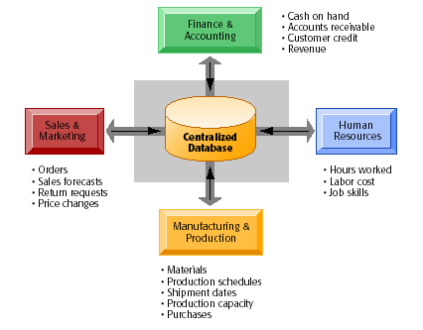
Management Information Systems
Chapter 11 Enterprise Applications and Business Process
Integration
ENTERPRISE SYSTEMS
What Are Enterprise Systems?
Enterprise System Architecture
Figure 11-1

Slide 6
Management Information Systems
Chapter 11 Enterprise Applications and Business Process
Integration
ENTERPRISE SYSTEMS
How Enterprise Systems Work
Enterprise Systems:
Enterprise Resource Planning (ERP) systems
Interdependent software modules with a common central database that support basic internal business processes for finance and accounting, human resources, manufacturing and production, and sales and marketing

Slide 7
Management Information Systems
Chapter 11 Enterprise Applications and Business Process
Integration
ENTERPRISE SYSTEMS
How Enterprise Systems Work (Continued)
Enterprise Systems: (Continued)
Enables data to be used by multiple functions and business processes for precise organizational coordination and control.

Slide 8
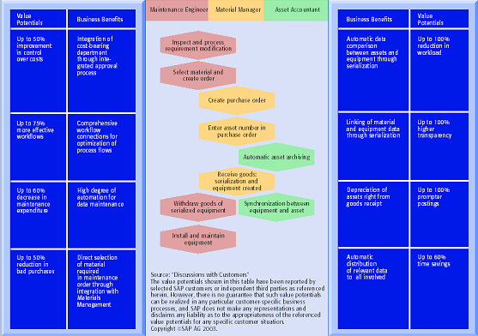
Management Information Systems
Chapter 11 Enterprise Applications and Business Process
Integration
ENTERPRISE SYSTEMS
Process Map for Procuring New Equipment
Figure 11-2

Slide 9
Management Information Systems
Chapter 11 Enterprise Applications and Business Process
Integration
ENTERPRISE SYSTEMS
Business Value of Enterprise Systems
A more uniform organization
More efficient operations and customer-driven business processes
Firmwide information for improved decision making

Slide 10
Management Information Systems
Chapter 11 Enterprise Applications and Business Process
Integration
SUPPLY CHAIN MANAGEMENT SYSTEMS
The Supply Chain
Supply chain:
Network of organizations and business processes for procuring raw materials, transforming into products, and distributing them to customers
Materials, information, and payments flow through the supply chain in both directions.

Slide 11
Management Information Systems
Chapter 11 Enterprise Applications and Business Process
Integration
SUPPLY CHAIN MANAGEMENT SYSTEMS
The Supply Chain (Continued)
Supply chain management:
Coordination of business processes to speed information, product, and fund flows up and down a supply chain to reduce time, redundant effort, and inventory costs

Slide 12
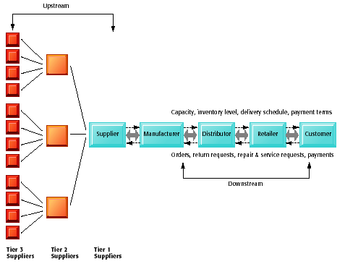
Management Information Systems
Chapter 11 Enterprise Applications and Business Process
Integration
SUPPLY CHAIN MANAGEMENT SYSTEMS
A Supply Chain
Figure 11-3

Slide 13
Management Information Systems
Chapter 11 Enterprise Applications and Business Process
Integration
SUPPLY CHAIN MANAGEMENT SYSTEMS
Supply Chain Processes
SCOR (Chain Operations Reference Model) identifies five major supply chain processes:
Plan: Balancing demand and supply to meet sourcing, production, and delivery requirements
Source: Procurement of goods and services needed to create a product or service

Slide 14
Management Information Systems
Chapter 11 Enterprise Applications and Business Process
Integration
SUPPLY CHAIN MANAGEMENT SYSTEMS
Supply Chain Processes (Continued)
Make: Processes that transform a product into a finished state
Deliver: Processes to manage order transportation and distribution
Return: Processes associated with product returns and post delivery customer support

Slide 15
Management Information Systems
Chapter 11 Enterprise Applications and Business Process
Integration
SUPPLY CHAIN MANAGEMENT SYSTEMS
Supply Chain Processes (Continued)
Logistics:
Planning and control of all factors that have an impact on the supply chain

Slide 16
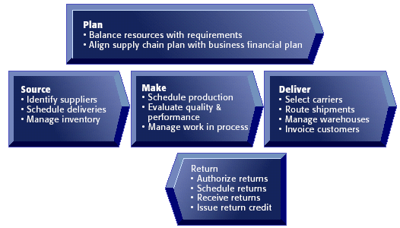
Management Information Systems
Chapter 11 Enterprise Applications and Business Process
Integration
SUPPLY CHAIN MANAGEMENT SYSTEMS
Key Supply Chain Management Processes
Figure 11-4

Slide 17
Management Information Systems
Chapter 11 Enterprise Applications and Business Process
Integration
SUPPLY CHAIN MANAGEMENT SYSTEMS
Information and Supply Chain Management
Inaccurate or untimely information causes inefficiencies in supply chain, such as shortages, excessive inventory
Just-in-time strategy :
Scheduling system for minimizing inventory by having components arrive exactly at the moment they are needed and finished goods shipped as soon as they leave the assembly line

Slide 18
Management Information Systems
Chapter 11 Enterprise Applications and Business Process
Integration
SUPPLY CHAIN MANAGEMENT SYSTEMS
Information and Supply Chain Management (Continued)
Bullwhip effect:
Distortion of information about the demand for a product as it passes from one entity to the next across the supply chain

Slide 19
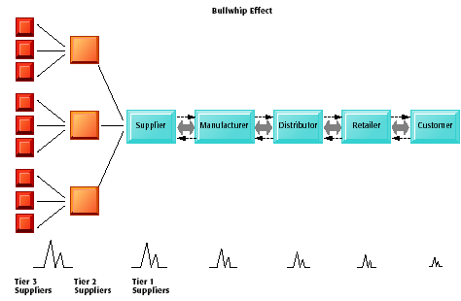
Management Information Systems
Chapter 11 Enterprise Applications and Business Process
Integration
SUPPLY CHAIN MANAGEMENT SYSTEMS
The Bullwhip Effect
Figure 11-5

Slide 20
Management Information Systems
Chapter 11 Enterprise Applications and Business Process
Integration
SUPPLY CHAIN MANAGEMENT SYSTEMS
Supply Chain Management Applications
Supply chain management systems: Automate flow of information between company and supply chain partners
Supply chain planning systems: Generate demand forecasts for a product (demand planning) and help develop sourcing and manufacturing plans for that product

Slide 21
Management Information Systems
Chapter 11 Enterprise Applications and Business Process
Integration
SUPPLY CHAIN MANAGEMENT SYSTEMS
Supply Chain Management Applications (Continued)
Supply chain execution systems:
Manage the flow of products through distribution centers and warehouses to ensure that products are delivered to the right locations in the most efficient manner

Slide 22
Management Information Systems
Chapter 11 Enterprise Applications and Business Process
Integration
SUPPLY CHAIN MANAGEMENT SYSTEMS
Supply Chain Performance Measurement
Metrics for measuring supply chain performance:
Fill rate (the ability to fill orders by the due date)
Average time from order to delivery
The number of days of supply in inventory
Forecast accuracy
The cycle time for sourcing and making a product

Slide 23
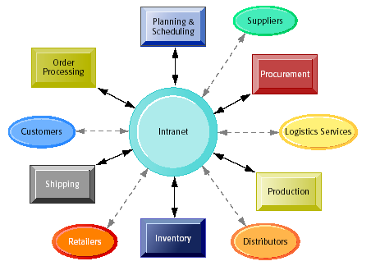
Management Information Systems
Chapter 11 Enterprise Applications and Business Process
Integration
SUPPLY CHAIN MANAGEMENT SYSTEMS
Supply Chain Management and the Internet
Intranets and Extranets for Supply Chain Management
Figure 11-6

Slide 24
Management Information Systems
Chapter 11 Enterprise Applications and Business Process
Integration
SUPPLY CHAIN MANAGEMENT SYSTEMS
Internet-based supply chain management applications:
Provide standard set of tools
Facilitate global supply chains
Reduce costs
Enable efficient customer response
Allow concurrent supply chains

Slide 25
Management Information Systems
Chapter 11 Enterprise Applications and Business Process
Integration
SUPPLY CHAIN MANAGEMENT SYSTEMS
Push-based model:
Production master schedules based on forecasts of demand for products, and products are “pushed” to customers
Pull-based model:
Supply chain driven by actual customer orders or purchases

Slide 26
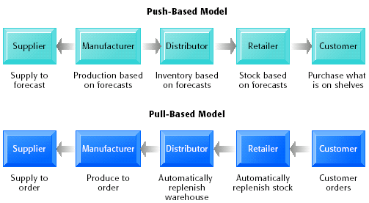
Management Information Systems
Chapter 11 Enterprise Applications and Business Process
Integration
SUPPLY CHAIN MANAGEMENT SYSTEMS
Push- versus Pull-Based Supply Chain Models
Figure 11-7

Slide 27
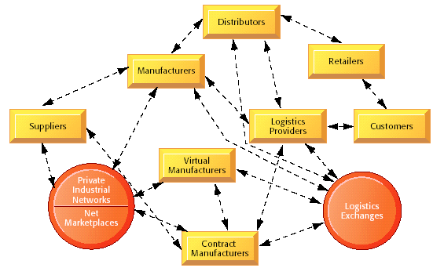
Management Information Systems
Chapter 11 Enterprise Applications and Business Process
Integration
SUPPLY CHAIN MANAGEMENT SYSTEMS
The Future Internet-Driven Supply Chain
Figure 11-8

Slide 28
Management Information Systems
Chapter 11 Enterprise Applications and Business Process
Integration
SUPPLY CHAIN MANAGEMENT SYSTEMS
Business Value of Supply Chain Management Systems
Improved customer service and responsiveness
Cost reduction
Cash utilization

Slide 29
Management Information Systems
Chapter 11 Enterprise Applications and Business Process
Integration
CUSTOMER RELATIONSHIP MANAGEMENT SYSTEMS
Customer Relationship Management and Partner Relationship Management
Customer Relationship Management (CRM):
Business and technology discipline for managing customer relationships to optimize revenue, profitability, customer satisfaction, and customer retention

Slide 30
Management Information Systems
Chapter 11 Enterprise Applications and Business Process
Integration
CUSTOMER RELATIONSHIP MANAGEMENT SYSTEMS
Partner Relationship Management (PRM):
Automation of the firm’s relationships with its selling partners using customer data and analytical tools to improve coordination and customer sales

Slide 31
Management Information Systems
Chapter 11 Enterprise Applications and Business Process
Integration
CUSTOMER RELATIONSHIP MANAGEMENT SYSTEMS
Customer Relationship Management Applications
CRM systems:
Capture and integrate customer data from all over the organization
Consolidate and analyze the data
Distribute results to various systems and customer touch points across the enterprise

Slide 32
Management Information Systems
Chapter 11 Enterprise Applications and Business Process
Integration
CUSTOMER RELATIONSHIP MANAGEMENT SYSTEMS
Customer Relationship Management Applications (Continued)
Touch point:
A method of interaction with a customer, such as telephone, e-mail, customer service desk, conventional mail, Web site, or retail store

Slide 33
Management Information Systems
Chapter 11 Enterprise Applications and Business Process
Integration
CUSTOMER RELATIONSHIP MANAGEMENT SYSTEMS
Customer Relationship Management (CRM) Software
Can range from niche tools to large-scale enterprise applications
Can link to other major enterprise applications, such as supply chain management
Can include modules for PRM and employee relationship management (ERM)

Slide 34
Management Information Systems
Chapter 11 Enterprise Applications and Business Process
Integration
CUSTOMER RELATIONSHIP MANAGEMENT SYSTEMS
Customer Relationship Management (CRM) Software (Continued)
Typically include capabilities for
Sales Force Automation (SFA)
Customer service
Marketing

Slide 35
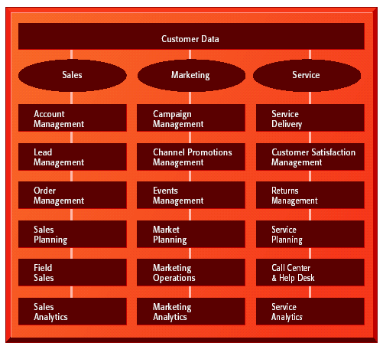
Management Information Systems
Chapter 11 Enterprise Applications and Business Process
Integration
CUSTOMER RELATIONSHIP MANAGEMENT SYSTEMS
CRM Software Capabilities
Figure 11-9

Slide 36
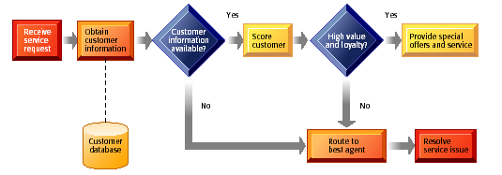
Management Information Systems
Chapter 11 Enterprise Applications and Business Process
Integration
CUSTOMER RELATIONSHIP MANAGEMENT SYSTEMS
Customer Loyalty Management Process Map
Figure 11-10

Slide 37
Management Information Systems
Chapter 11 Enterprise Applications and Business Process
Integration
CUSTOMER RELATIONSHIP MANAGEMENT SYSTEMS
Operational and Analytical CRM
Operational CRM:
Customer-facing applications, such as sales force automation, call center and customer service support, and marketing automation
Examples: Campaign management, e-marketing, account and contact management, lead management, telemarketing, teleselling, e-selling, field sales

Slide 38
Management Information Systems
Chapter 11 Enterprise Applications and Business Process
Integration
CUSTOMER RELATIONSHIP MANAGEMENT SYSTEMS
Analytical CRM:
Applications that analyze customer data generated by operational CRM applications to provide information for improving business performance
Examples: Develop customer segmentation strategies and customer profiles; analyze customer or product profitability; identify trends in sales length cycle; analyze leads generated and conversion rates

Slide 39
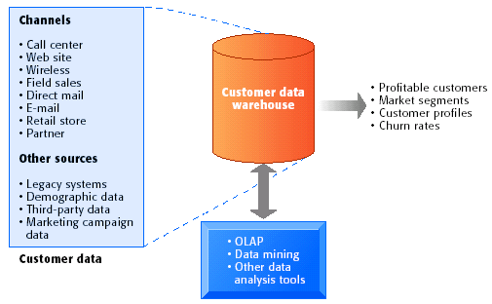
Management Information Systems
Chapter 11 Enterprise Applications and Business Process
Integration
CUSTOMER RELATIONSHIP MANAGEMENT SYSTEMS
Analytical CRM Data Warehouse
Figure 11-11

Slide 40
Management Information Systems
Chapter 11 Enterprise Applications and Business Process
Integration
CUSTOMER RELATIONSHIP MANAGEMENT SYSTEMS
Business Value of Customer Relationship Management Systems
Increased customer satisfaction
More effective marketing and reduced direct marketing costs
Lower costs for customer acquisition and retention

Slide 41
Management Information Systems
Chapter 11 Enterprise Applications and Business Process
Integration
CUSTOMER RELATIONSHIP MANAGEMENT SYSTEMS
Business Value of Customer Relationship Management Systems (Continued)
Increased revenue from identifying most profitable customers and segments for marketing, cross-selling, up-selling
Reduce churn rate:
Number of customers who stop using or purchasing products or services from a company

Slide 42
Management Information Systems
Chapter 11 Enterprise Applications and Business Process
Integration
CUSTOMER RELATIONSHIP MANAGEMENT SYSTEMS
The Importance of CRM Performance Measurement
Successful CRM implementations require that financial and operation goals, and metric for evaluation, are clearly defined at outset of project
Metrics for CRM may include:
Cost per lead
Cost per sale

Slide 43
Management Information Systems
Chapter 11 Enterprise Applications and Business Process
Integration
CUSTOMER RELATIONSHIP MANAGEMENT SYSTEMS
The Importance of CRM Performance Measurement (Continued)
Number of repeat customers
Reduction of churn
Sales closing rate
Customer Lifetime Value (CLTV): Difference between revenues and expenses minus the cost of promotional marketing used to retain an account

Slide 44
Management Information Systems
Chapter 11 Enterprise Applications and Business Process
Integration
ENTERPRISE INTEGRATION TRENDS
Service Platforms and Business Process Management
Service Platform:
Integration of multiple applications from multiple business functions, business units, or business partners to deliver a seamless experience for the customer, employee, manager, or business partner

Slide 45
Management Information Systems
Chapter 11 Enterprise Applications and Business Process
Integration
ENTERPRISE INTEGRATION TRENDS
Business Process Management:
A methodology for dealing with the organization’s need to change its business processes continually to remain competitive
Portals: Frameworks for building composite services, integrating information form enterprise applications and in-house legacy systems

Slide 46
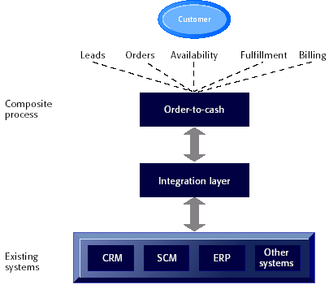
Management Information Systems
Chapter 11 Enterprise Applications and Business Process
Integration
ENTERPRISE INTEGRATION TRENDS
Order-to-Cash Service
Figure 11-12

Slide 47
Management Information Systems
Chapter 11 Enterprise Applications and Business Process
Integration
MANAGEMENT OPPORTUNITIES, CHALLENGES AND SOLUTIONS
Management Opportunities:
Improvement of process coordination and management decision making
Reductions in inventory costs, order-to-delivery time, and more efficient customer response and higher product and customer profitability

Slide 48
Management Information Systems
Chapter 11 Enterprise Applications and Business Process
Integration
MANAGEMENT OPPORTUNITIES, CHALLENGES AND SOLUTIONS
Management Challenges:
High total cost of ownership
Organizational change requirements
Realizing strategic value

Slide 49
Management Information Systems
Chapter 11 Enterprise Applications and Business Process
Integration
MANAGEMENT OPPORTUNITIES, CHALLENGES AND SOLUTIONS
Solution Guidelines:
Look at business objectives first
Attention to data and data management
Senior management commitment and employee support
Education and training

